Slide 1
EVENT FLOW Event Planning Application
Project Presentation

Slide 2
Introduction
Purpose of the System:
To provide a seamless and efficient tool for planning, organizing, and managing all types of events.
Enables real-time coordination and collaboration among event organizers, vendors, and participants.
Target Audience:
Community centers, educational institutions, and corporate event coordinators.
Objectives:
Simplify the event management process through automation.
Enhance user experience with intuitive design and comprehensive features.
Ensure scalability and reliability to handle events of any size.

Slide 3
System Overview
Architecture:
Utilizes a three-tier architecture comprising the presentation layer, business logic layer, and data access layer. This separation enhances system scalability and maintainability.
Technologies Used:
Frontend: HTML5, CSS- for a dynamic and responsive user interface.
Backend: Python, PHP - robust and scalable for handling complex backend logic.
Database: MYSQL - ensures reliable data storage and complex query processing.
Other Tools: Docker for containerization, Git for version control, and Jenkins for continuous integration.
Deployment:
Deployed on XAMPP for availability and scalability.

Slide 4
Features
User Registration and Management:
Secure sign-up and login functionality.
Profile management for users to update their information.
Event Creation and Management:
Tools to create and edit event details such as date, time, location, and description.
Options for setting up recurring events and reminders.
Booking System:
Integrated platform for ticket sales including multiple pricing tiers and discount options.
Real-time tracking of ticket sales and attendee registration.
Interactive Venue Maps:
Maps showing event layouts and seating arrangements, which can be interactively explored by attendees.
Reporting and Analytics:
Dashboard for real-time insights on attendance, revenue from ticket sales, and participant feedback.
Tools for generating post-event reports to analyze success and areas for improvement.

Slide 5
Development Methodology
Chosen Methodology:
Verification & Validation: Emphasizing flexibility, continuous feedback, and iterative progress through sprints.
Phases of Development:
Planning: Requirement gathering, scope definition, and sprint planning.
Design: UI/UX design iterations and system architecture planning.
Development: Coding, continuous integration, and regular sprint reviews.
Testing: Unit testing, integration testing, and user acceptance testing (UAT).
Deployment: Staging and production deployment with monitoring and rollback strategies.
Maintenance: Ongoing support, bug fixing, and system upgrades.
Tools and Practices:
Version Control: Git for tracking revisions and collaborating.
Project Management: Jira for tracking tasks, deadlines, and agile metrics.
Team Collaboration:
Regular stand-up meetings to discuss progress, obstacles, and next steps.
Sprint retrospectives to refine processes and improve efficiency.

Slide 6
Database Design
Core Tables and Their Functions:
Users: Stores user information, preferences, and roles (e.g., attendee, organizer).
Venues: Contains details about each event, such as title, description, venue, date, and time.
Booking: Manages ticket types, pricing, and availability. Links to Events and Users for purchases.
Data Integrity and Security:
Use of constraints and indexes to ensure data integrity and efficient access.
Implementation of encryption and access controls to protect sensitive data.
Optimization and Scalability:
Database normalization to eliminate data redundancy and improve query performance.
Strategies for scaling the database, such as replication and partitioning, to handle high loads during peak times.

Slide 7
User Interface Design
Design Philosophy:
User-Centric Approach: Focus on creating an intuitive and accessible interface for all user types.
Consistency: Uniform design elements across all screens to ensure a seamless user experience.
Responsiveness: Ensures optimal viewing and interaction experience across all devices and screen sizes.
Key UI Elements:
Navigation Bar: Simple and clear, providing easy access to all major sections like Home, Events, My Tickets, and Support.
Dashboard: Central hub for users to view upcoming events, manage tickets, and receive notifications.
Event Pages: Detailed pages for each event, featuring descriptions, venue maps, speaker profiles, and ticket options.

Slide 8
Testing and Validation
Testing Strategies:
Unit Testing: Ensure each component functions correctly in isolation.
Integration Testing: Check modules work together as expected.
System Testing: Evaluate the complete system’s performance against the requirements.
User Acceptance Testing (UAT): Conducted with real users to ensure the system meets their needs and expectations.
Quality Assurance Measures:
Regular code reviews and pair programming sessions to maintain code quality.
Performance testing to evaluate system responsiveness and stability under load.
Documentation:
Comprehensive test cases and outcomes documented for future reference and compliance.
This slide demonstrates your commitment to quality and reliability through rigorous testing and user feedback integration.

Slide 9
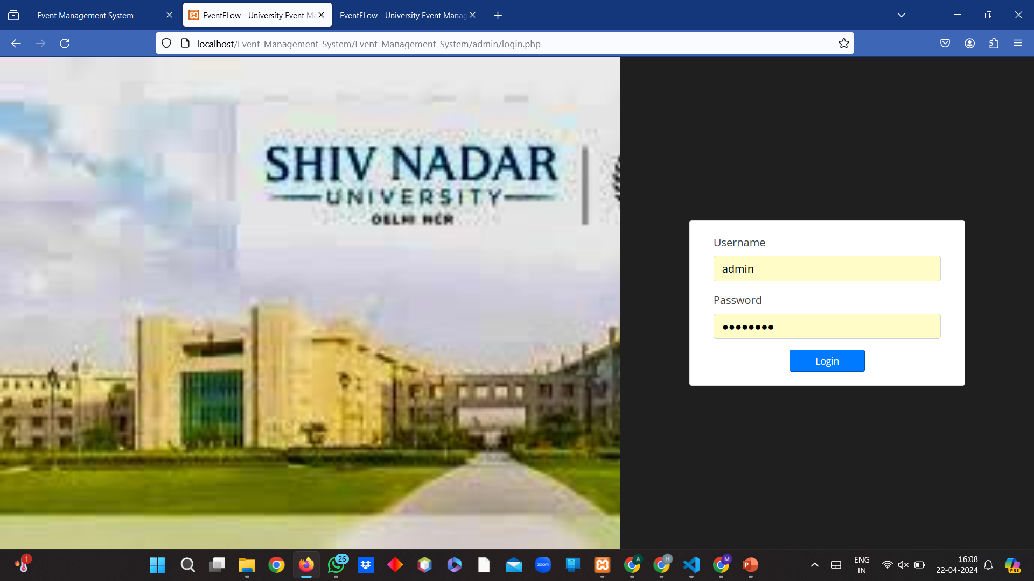
Login Page

Slide 10
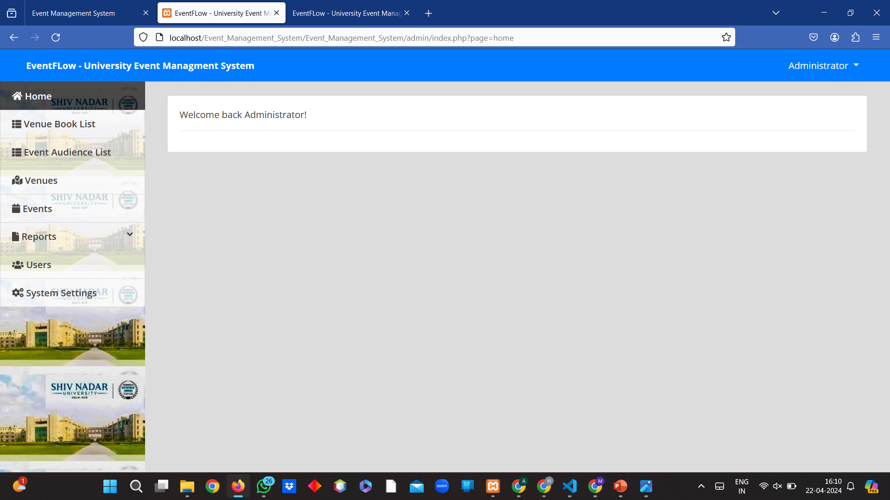
Homepage

Slide 11
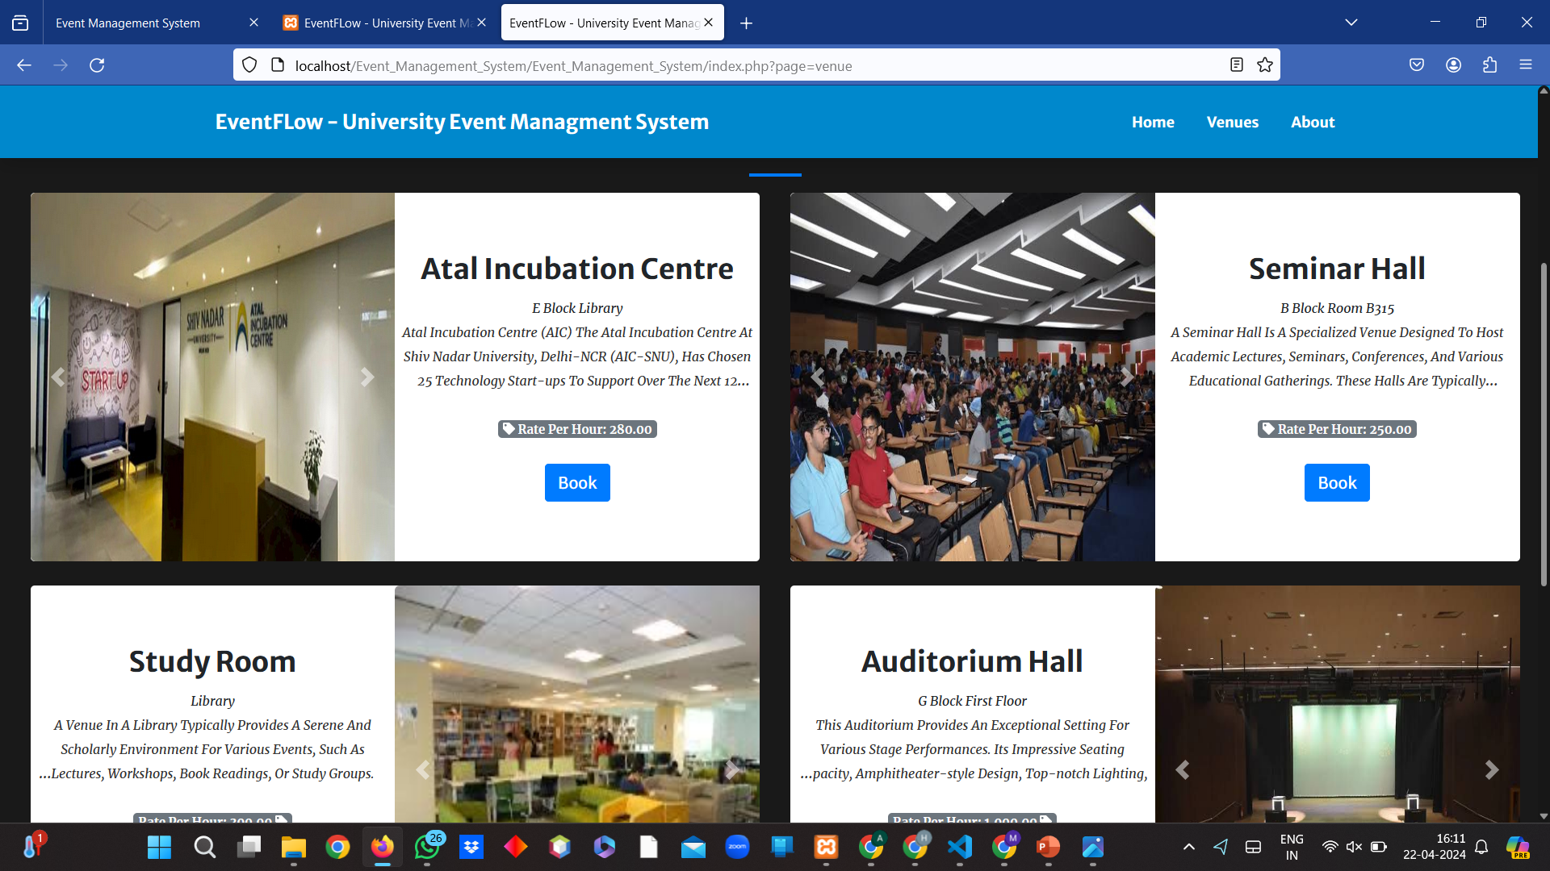
Booking Event Page

Slide 12
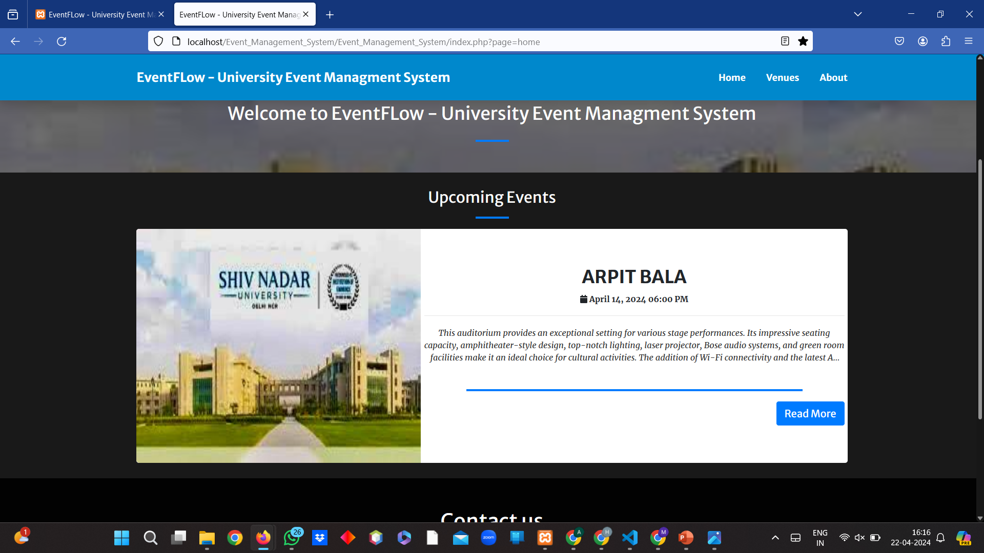
Events Info Page

Slide 13
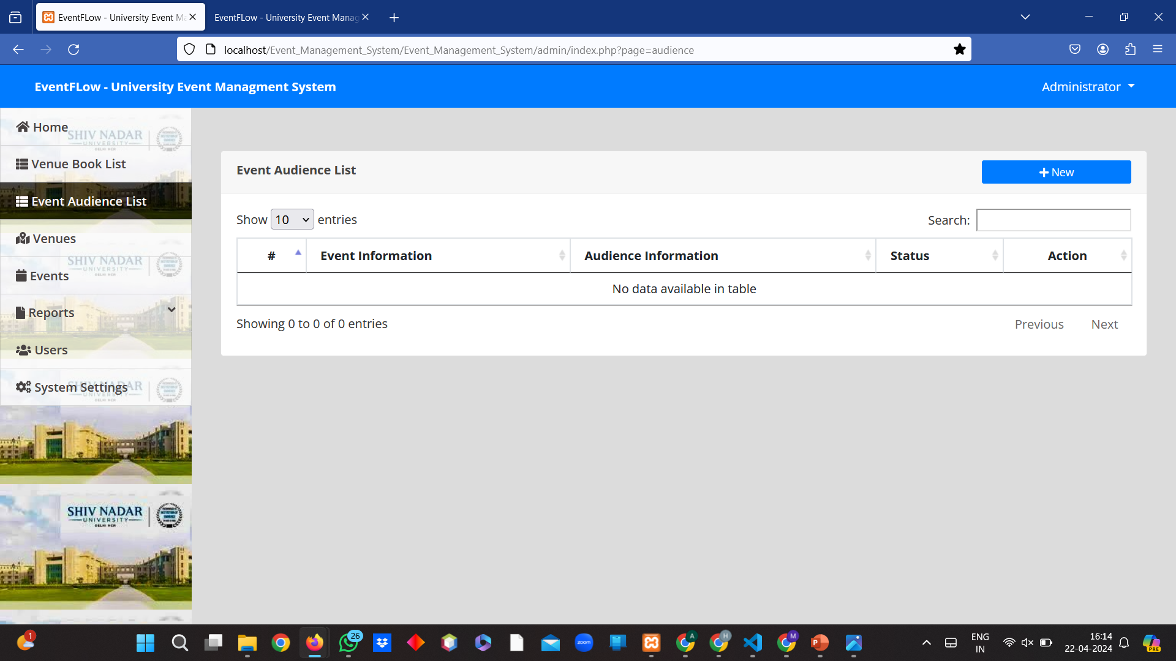
Guest List Page

Slide 14
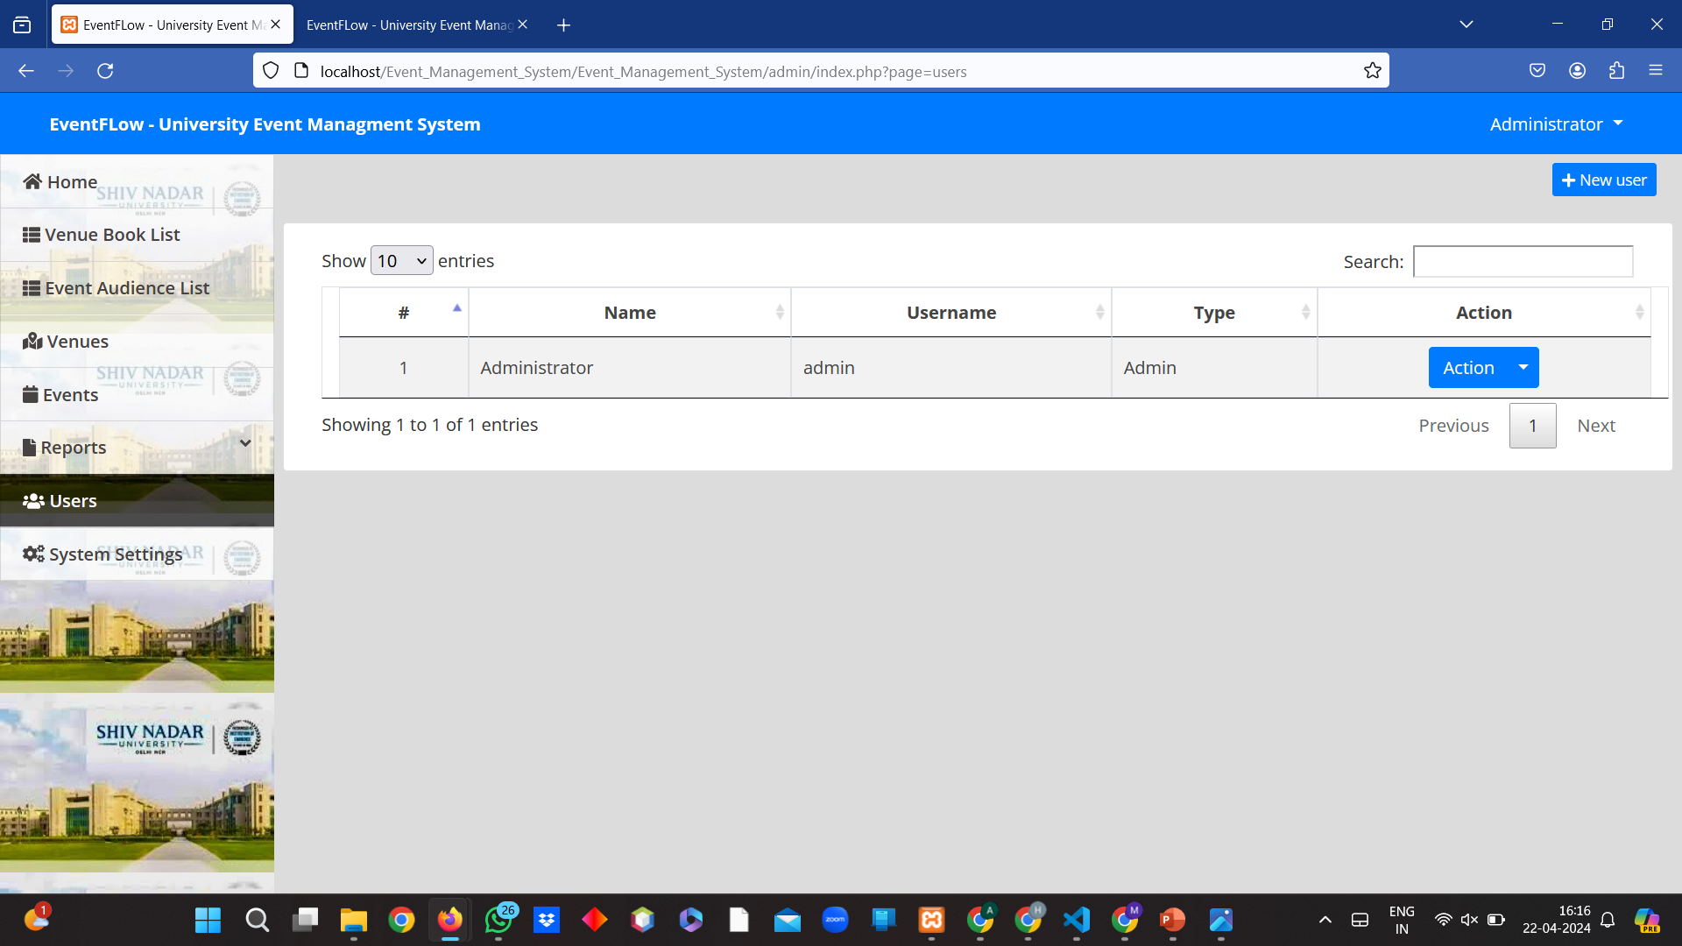
Admin Page

Slide 15
Conclusion
Summary of Achievements:
Successfully developed a fully functional Event Management System tailored to both casual and professional event organizers.
Implemented advanced features such as real-time notifications, interactive venue maps, and a multi-tier ticketing system.
Ensured high usability and accessibility standards, confirmed through extensive user testing.
Key Learnings:
Importance of agile project management in adapting to changing requirements and deadlines.
The role of continuous user feedback in creating a user-centered design.
Future Directions:
Enhancements to mobile applications to improve user experience on the go.

Slide 16


